Slide 1

Angular Quick Start
By CDO Team
v1.0

Slide 2
Rev. History
Rev. | Change Summary | Updated By | Reviewed
1.0 | Initial | Hung Tran, Phong Ha, Bang Ngo, Bao Huynh | Huy Tran, Cuong Do

Slide 3
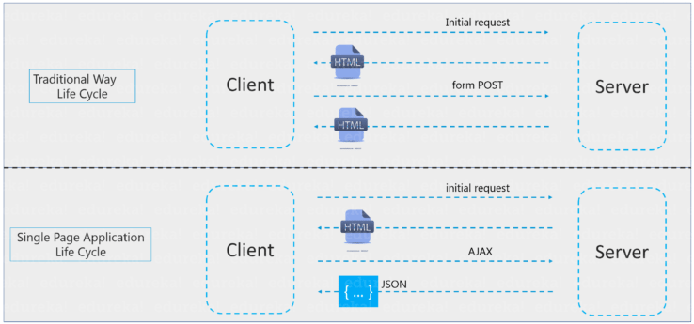
What is Angular
Angular is a client-side JavaScript framework that was specifically designed to help developers build SPAs (Single Page Applications) in accordance with best practices for web development. By providing a structured environment for building SPAs, the risk of producing “spaghetti code” is highly reduced.
Notes:
Single-Page Applications (or SPA’s) are applications that are accessed via a web browser like other websites but offer more dynamic interactions resembling native mobile and desktop apps. The most notable difference between a regular website and SPA is the reduced amount of page refreshes. SPAs have a heavier usage of AJAX- a way to communicate with back-end servers without doing a full page refresh to get data loaded into our application. As a result, the process of rendering pages happens mostly on the client-side.

Slide 4
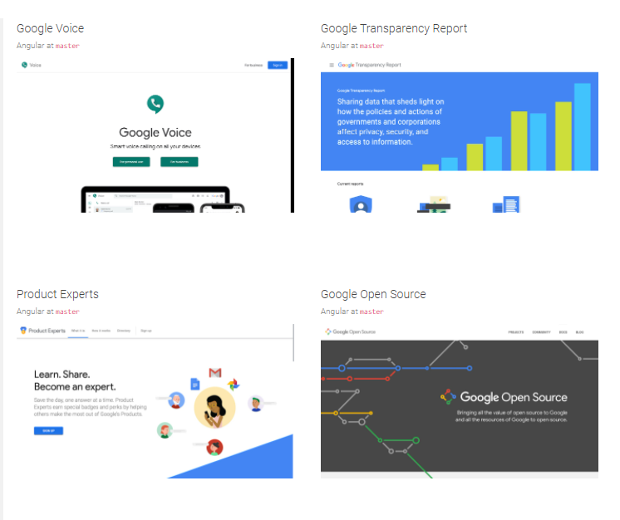
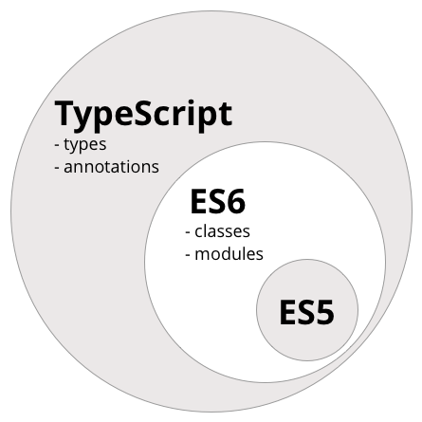
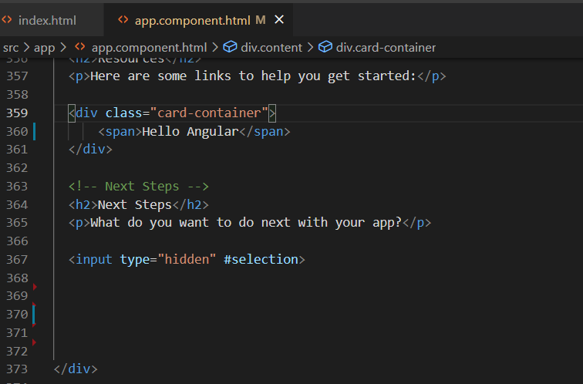
Why choosing Angular
Supported by Google
Typescript
Declarative UI

Slide 5
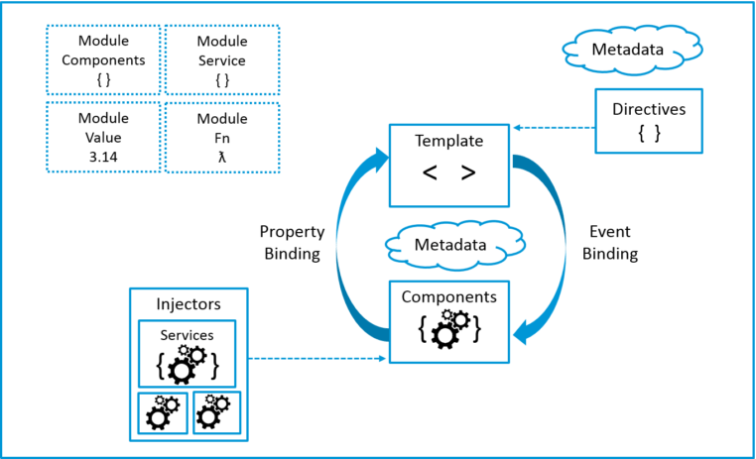
Angular Architecture
Modules
Components
Templates
Metadata
Data binding
Directives
Services
Dependency injection

Slide 6
Angular CLI
The Angular CLI is a command-line interface tool that you use to initialize, develop, scaffold, and maintain Angular applications directly from a command shell.
npm install -g @angular/cli
ng extract-i18n <project> [options]
ng i18n-extract <project> [options]
ng xi18n <project> [options]
ng new <project name>
ng generate <type> <name> [options]
ng build
ng test
ng e2e

Slide 7
Angular coding style
Separate file names with dots and dashes
Do use dashes to separate words in the descriptive name.
Do use dots to separate the descriptive name from the type.
like: my-feature.type.ts
Use lower camel case for naming the selectors of directives.
Unit test file names
Do name test specification files the same as the component they test.
Do name test specification files with a suffix of .spec.
Folders-by-feature structure.
Do keep a flat folder structure as long as possible

Slide 8
Modules Angular Architecture
Angular apps are modular:
An application defines a set of Angular Modules or NgModules.
Every angular module is a class with an @NgModule decorator.
Every Angular App has at least one module: the root module.
There are other feature modules:
Cohesive block of code, dedicated to an application domain, a workflow, or a closely related set of capabilities.
NgModule takes a single metadata object describing the module, with the following properties
declarations: The classes that are related to views and they belong to this module. There are three classes of Angular that can contain view: components, directives, and pipes
exports: subset of public declarations, usable in the templates of other modules
imports: external modules needed by the templates of this module
providers: creators of services that this module contributes to
bootstrap: The main application view, called the root component, which hosts all other app views

Slide 9
Demo
Create root module
Create feature module

Slide 10
Components Angular Architecture
A component controls a patch of screen called a view. For example, individual components define and control each of the following views from the Employee Demo:
The app root with the navigation links.
The list of employees.
The employee editor.
etc
Inside the component, you define a component's application logic—what it does to support the view—inside a class. The class interacts with the view through an API of properties and methods.
Notes:
This template uses typical HTML elements like <h2> and also includes Angular template-syntax elements, *ngFor, {{employee.username}}, [employee], and <app-employee-detail>. The template-syntax elements tell Angular how to render the HTML to the screen, using program logic and data.

Slide 11
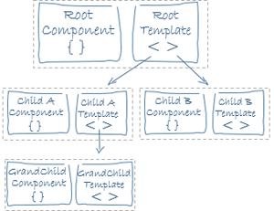
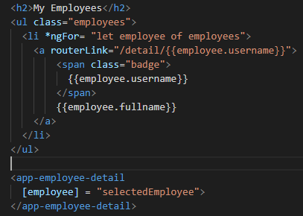
Templates Angular Architecture
A snippet of the HTML code of a component
A component’s view is defined with its template
Uses Angular’s template syntax, with custom elements.
Notes:
This template uses typical HTML elements like <h2> and also includes Angular template-syntax elements, *ngFor, {{employee.username}}, [employee], and <app-employee-detail>. The template-syntax elements tell Angular how to render the HTML to the screen, using program logic and data.

Slide 12
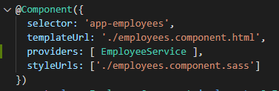
Metadata Angular Architecture
Tells Angular how to process a class
Uses decorators to attach information to a class:
@Component: identifies the class below it as a component class, with options:
selector: CSS selector for the template code
templateURL: address of the component’s HTML template
providers: array of dependency injection providers for services that the component requires
styleUrls: the path of the CSS style sheet
Other metadata decorators: @Injectable, @Input, @Output…

Slide 13
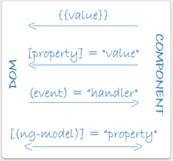
Data Binding Angular Architecture
Angular supports Data Binding
Mechanism for coordinating parts of a template with parts of a component
The following diagram shows the four forms of data binding markup. Each form has a direction: to the DOM, from the DOM, or both.
interpolation {{value}} displays the component's property value within the tag element.
property binding [property] passes the value from the parent to the child
event binding (click) calls the compnent’s method when user click on HTML
Two-way data binding [(ngModel)]

Slide 14
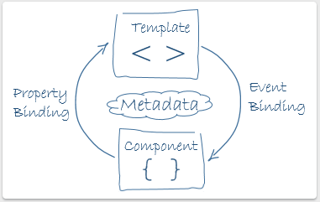
Two-way Data Binding Angular Architecture
In two-way binding, a data property value flows to the input box from the component as with property binding. The user's changes also flow back to the component, resetting the property to the latest value, as with event binding.

Slide 15
Directives Angular Architecture
Angular templates are dynamic.
When Angular renders them, it transforms the DOM according to the instructions given by directives.
A directive is a class with a @Directive decorator.
A component is a directive-with-a-template;
A @Component decorator is actually a @Directive decorator extended with template-oriented features.
Appear within an element tag as attributes do
Two types of directives
Structural directives
Attribute directives

Slide 16

Directives Angular Architecture
Structural directives
Alter the layout by adding, removing and replacing elements in the DOM
Attribute directives
Alter the appearance or behaviour of an existant element
Look like regular HTML attributes
Custom attributes
You can write your own directives

Slide 17
Demo
Create components

Slide 18
Services Angular Architecture
Almost anything can be a service
A class with a narrow, well-defined purpose
Ex: logging service, data service, application configurations,…
There is no specific definition of a class in Angular, but classes are fundamental to any Angular application
Component classes should be lean
They shouldn’t fetch data from the server, validate user input or log directly to the console
They just deal with user experience, mediate between the view and the logic
Everything non trivial should be delegated to services
A service is associated to a component using dependency injection

Slide 19

Dependency injection (DI)
Important application design pattern
Commonly called DI
A way to supply a new instance of a class with the fully-formed dependencies it requires
Most dependencies are services
DI is used to provide new components with the services they need.
It knows which services to instantiate by looking at the types of the component’s constructor parameters
When Angular creates a component, it ask an injector for the services it requires

Slide 20
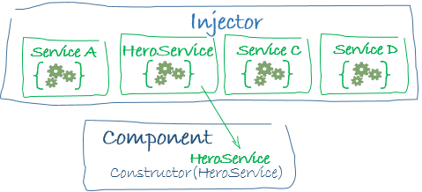
Injector Dependency injection (DI)
Maintains a container of service instances that it has previously created
If a requested service instance is not in the container, the injector makes one and adds it to the container before returning the service to Angular
When all requested services have been resolved and returned, Angular can call the component's constructor with those services as arguments.

Slide 21
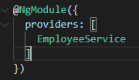
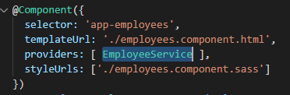
Provider Dependency injection (DI)
In order for the injector to know which services to instantiate, you need to register a provider of each one of them
Provider: creates or returns a service
It is registered in a module or a component
Add it to the root module for it to be available everywhere
Register it in the component to get a new instance of the service with each new instance of the component

Slide 22
@Injectable() Dependency injection (DI)
@Injectable() marks a class as available to an injector for instantiation
It is mandatory if the service class has and injected dependency
For ex: if the service needs another service, which is injected in it
It is highly recommended to add an @Injectable() decorator for every service class for the sake of
Future proofing
Consistency
All components and directives are already subtypes of Injectable
Event though they are instantiated by the injector, you don’t have to add the @Injectable() decorator to them

Slide 23
Demo
Create service

Slide 24
Routing
In a single-page app, you change what the user sees by showing or hiding portions of the display that correspond to particular components, rather than going out to the server to get a new page. As users perform application tasks, they need to move between the different views that you have defined.
To handle the navigation from one view to the next, you use the Angular Router. The Router enables navigation by interpreting a browser URL as an instruction to change the view.

Slide 25
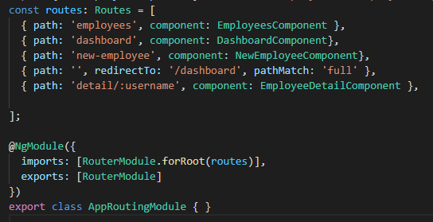
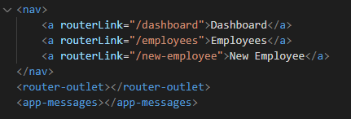
Routing
The CLI also sets up a Routes array for your routes and configures the imports and exports arrays for @NgModule()
path, defines the URL path for the route
component, defines the component Angular should use for the corresponding path.
Assign the anchor tag that you want to add the route to the routerLink attribute. Set the value of the attribute to the component to show when a user clicks on each link.
Next, update your component template to include <router-outlet>. This element informs Angular to update the application view with the component for the selected route.

Slide 26
Demo
Routing
Lazy loading

Slide 27
Lifecycle
A component instance has a lifecycle that starts when Angular instantiates the component class and renders the component view along with its child views. The lifecycle continues with change detection, as Angular checks to see when data-bound properties change, and updates both the view and the component instance as needed. The lifecycle ends when Angular destroys the component instance and removes its rendered template from the DOM. Directives have a similar lifecycle, as Angular creates, updates, and destroys instances in the course of execution.
Your application can use lifecycle hook methods to tap into key events in the lifecycle of a component or directive in order to initialize new instances, initiate change detection when needed, respond to updates during change detection, and clean up before deletion of instances.

Slide 28
Lifecycle hooks
Lifecycle hooks are a special functionality in Angular that allow us to “hook into” and run code at a specific lifecycle event of a component or directive.
Angular manages components and directives for us when it creates them, updates them, or destroys them. With lifecycle hooks, we can gain better control of our application.
To do this, we add some specific hook methods prefixed with ng to our component or directive. These hooks are split into two types: hooks for components or directives, and hooks for child components.

Slide 29
Lifecycle event sequence
Angular executes hook methods in the following sequence. You can use them to perform the following kinds of operations.
ngOnChanges()
ngOnInit()
ngDoCheck()
ngAfterContentInit()
ngAfterContentChecked()
ngAfterViewInit()
ngAfterViewChecked()
ngOnDestroy()

Slide 30


Thank You!

